Slide 1
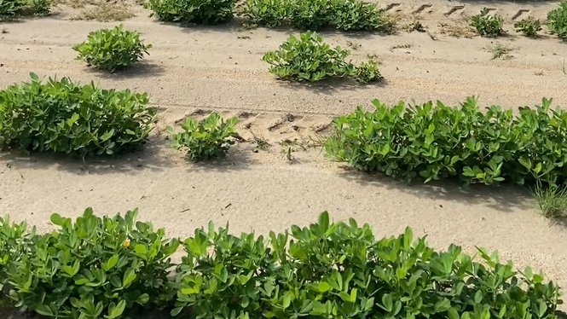
Peanut soil microbiome
Laura Rodriguez
PLPA-6820
Notes:
Prevalence of Aspergillus flavus in peanut soils

Slide 2
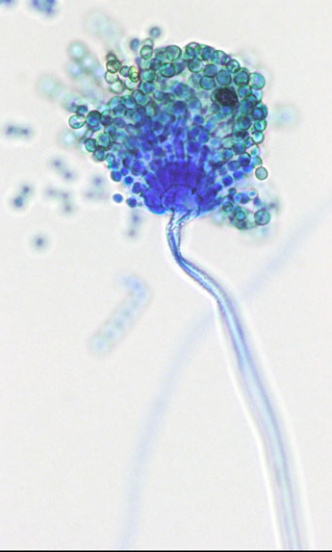
Background information
Peanut is an economically important crop mostly grown in Southeastern U.S.
Drought can affect abundance of soil microbial communities and the peanut plant
Under hot and dry conditions peanut is prone to Aspergillus flavus
Infecting crops with its mycotoxin: aflatoxin
Newer studies have shown that widespread fungi from Mortierella species have antagonistic effects against many plant pathogens and aid in plant stresses
Notes:
For this experiment I want to see if A. flavus and or mortierella are core microbiome

Slide 3
Objectives
Analyze data in R basic procedures to obtain the core microbiome of the soil
Detect changes in Aspergillus flavus relative abundance over time and water

Slide 4
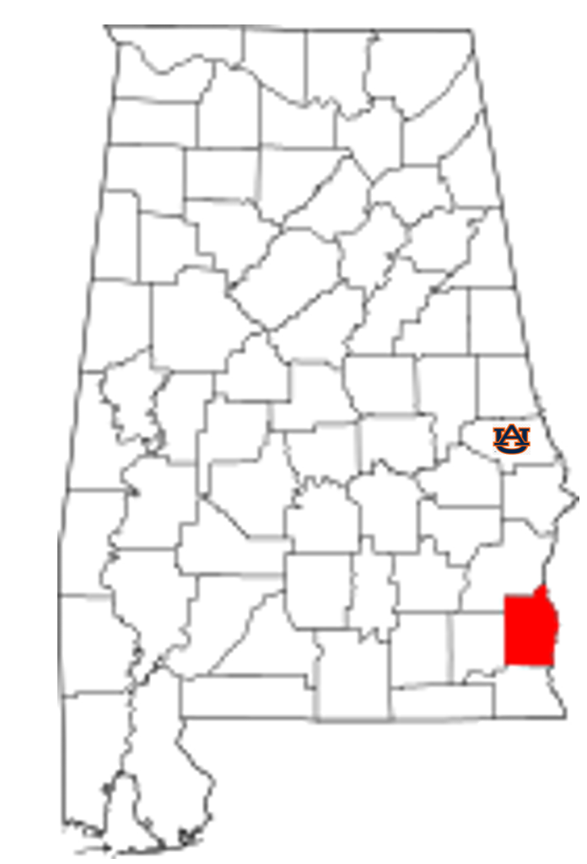
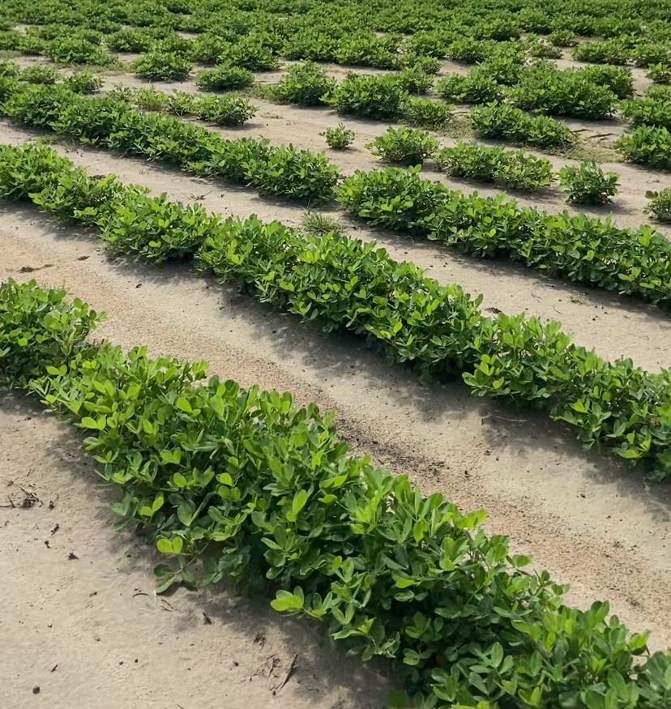
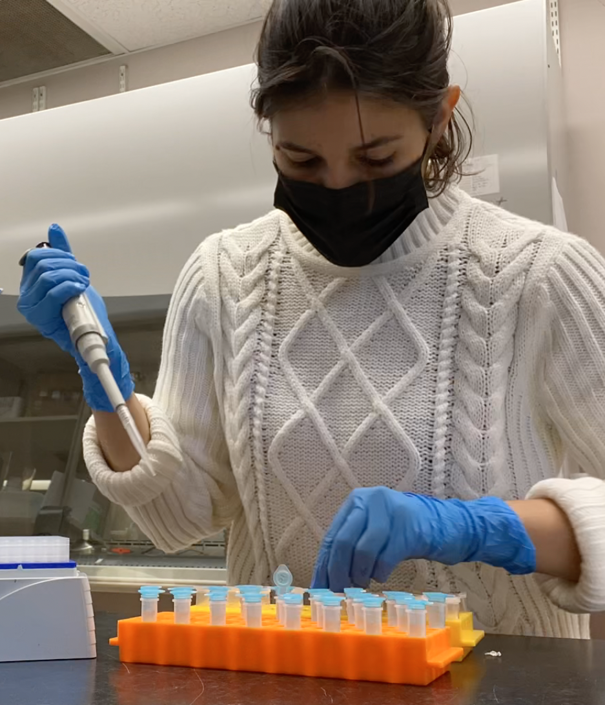
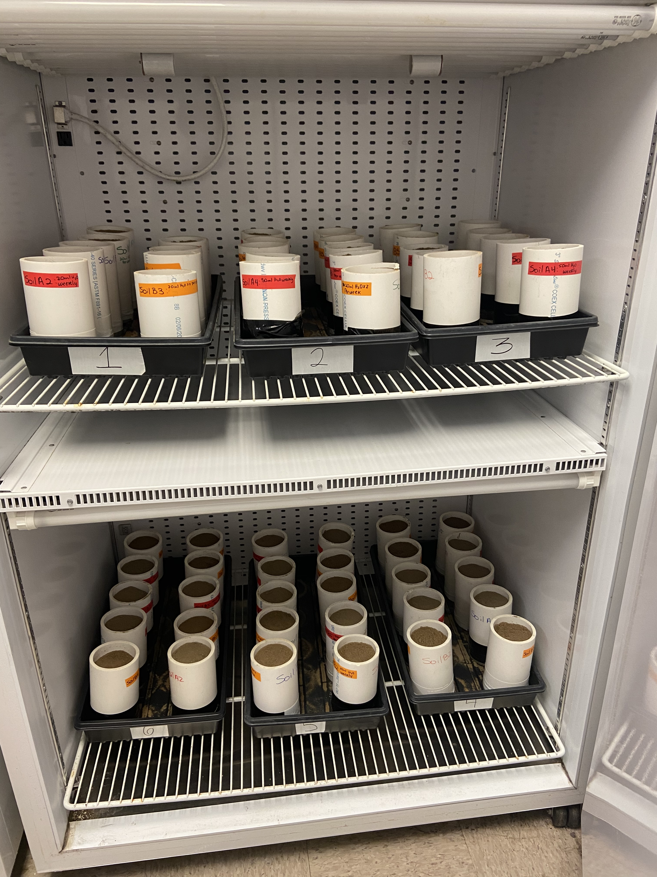
Method
Soil collection – Wiregrass Research and Extention Center (WREC)
Two soils – A and B
Filled PVC tubes and placed in incubator
Randomized complete block design 9 weeks
29ºC
Soil collected each week → DNA extraction
Treatments applied for each
1 = dry
2 = 20 ml of water weekly
3 = 20 ml of water twice a week
4 = 50 ml of water weekly
5 = 50 ml of water twice a week
→ library preparation → Sequencing
Notes:
mesh

Slide 5
Pipeline
Stripping primers
Run Stats
Filter
Clustering
R programming analysis
Mapping
Taxonomy

Slide 6


Slide 7
Decontaminate
Used decontam package

Slide 8
Rarefaction curve
Rarefaction is a technique to assess species richness from the results of sampling.
Rarefaction curve is a plot of the number of species as a function of the number of samples.
Rarefaction curves generally grow rapidly at first, as the most common
species are found, but the curves plateau as only the rarest species remain to be sampled.
Notes:
Rarefaction is a technique to assess species richness from the results of sampling.
Thus, allows the calculation of species richness for a given number of individual samples by using the rarefaction curve
Rarefaction curve is a plot of the number of species as a function of the number of samples.
Rarefaction curves generally grow rapidly at first, as the most common
species are found, but the curves plateau as only the rarest species remain to be sampled.

Slide 9
Principal coordinate chart: changes in soil
Test: dispersion of variance of two or more groups are significant
PCoA is a non-linear dimension reduction technique
Each point represents a single community
The closer the more similar and the further apart the more diverse
Notes:
Principal coordinate chart
Bacteri, Fungi
The week represent the colors, and Treatmetn represented by shape
Each point represent a single community. The closer they are the similar their communities are. The further apart the more diverse
Even though they are Geographically similar, we had the mos variation due to soil. So, different peanut soil differe in its communities.
We also observed changes in time and treatment. However, this picture depict the changes in soil
Beta diveristy
quantify the compositional dissimilarity between two different sites, based on counts at each site.
The Bray–Curtis dissimilarity is bounded between 0 and 1, where 0 means the two sites have the same composition (that is they share all the species), and 1 means the two sites do not share any species
---
DOI: https://doi.org/10.1128/mSystems.00363-21
Quantitative comparison among microbiomes can link microbial beta-diversity to environmental features, thus enabling prediction of ecosystem properties or dissection of host-microbiome interaction
# create bray-curtis distance matrix
is the ratio between regional and local species diversity.
the two groups dispersion overlap a great deal and are not distinct from each other. Again this shows that pathotype dispersion between the groups is homogeneous and not different in this instance.
in out case we don’t observe an overlap meaning that they are very distinc from each other
https://cran.r-project.org/web/packages/hagis/vignettes/betadiversity.html
microbiome 1: We used Permanova to see if 2 clusters are really different. Since we have lots of variation, we can use beta dispersion(next step). Collection and management are dependent of one another

Slide 10

Top 20 prevalent fungi
nBLAST results:
FOTU_1 : Mortierella angusta/simplex
FOTU_542 : Mortierella elongata
FOTU_10 : Fusarium equiseti
FOTU_11 : Epicoccum sorghinum
FOTU_2 : Fusarium solani
FOTU_3 : Fusarium solani
FOTU_4 : Curvularia hawaiiensis/spicifera

Slide 11
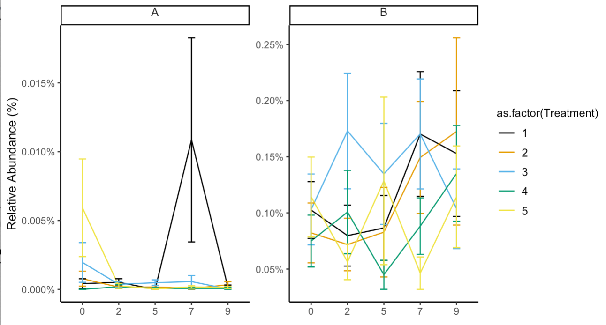
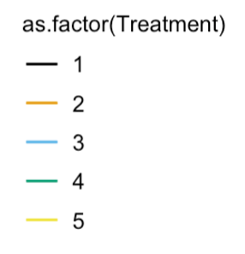
Relative abundance A. flavus
Relative Abundance (%)
weeks
Notes:
How important is the plant for Aspergillus flavus?

Slide 12
Differential abundance analysis
Analyzed: How many percentages of the microbiome are made up of a specific organism
FOTU_25 : Alternaria alternata
FOTU_1404 : Mortierella simplex

Slide 13
Core microbiome
The grey line (center) neutral model
Dashed lines are 95% confidence intervals around the model
Points above the model are selected by the (plant) environment
Points below the model are dispersal limited
Shades and Stopnisek, et al. 2019

Slide 15
Principal coordinate chart
Notes:
Principal coordinate chart
Bacteri, Fungi
The week represent the colors, and Treatmetn represented by shape
Each point represent a single community. The closer they are the similar their communities are. The further apart the more diverse
Even though they are Geographically similar, we had the mos variation due to soil. So, different peanut soil differe in its communities.
We also observed changes in time and treatment. However, this picture depict the changes in soil
Beta diveristy
quantify the compositional dissimilarity between two different sites, based on counts at each site.
The Bray–Curtis dissimilarity is bounded between 0 and 1, where 0 means the two sites have the same composition (that is they share all the species), and 1 means the two sites do not share any species
---
DOI: https://doi.org/10.1128/mSystems.00363-21
Quantitative comparison among microbiomes can link microbial beta-diversity to environmental features, thus enabling prediction of ecosystem properties or dissection of host-microbiome interaction
# create bray-curtis distance matrix
is the ratio between regional and local species diversity.
the two groups dispersion overlap a great deal and are not distinct from each other. Again this shows that pathotype dispersion between the groups is homogeneous and not different in this instance.
in out case we don’t observe an overlap meaning that they are very distinc from each other
https://cran.r-project.org/web/packages/hagis/vignettes/betadiversity.html
microbiome 1: We used Permanova to see if 2 clusters are really different. Since we have lots of variation, we can use beta dispersion(next step). Collection and management are dependent of one another

